Slide 1
FRB Update
William Huang (8/5/2020)

Slide 2
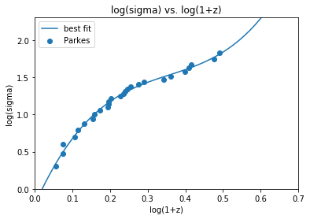
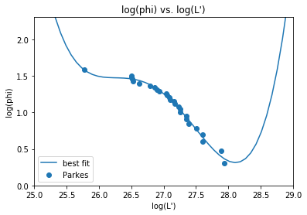
Polynomial fits of \dot{sigma} and \phi
In order to stay monotonic (at least within the range of known values), I visually checked for the lowest order polynomial that would be monotonic over the data values. I fit 3rd and 4th power polynomials for sigma and phi respectively.
25.3513x^3 - 27.1937x^2 + 11.358x - 0.2130
0.2913x^4 - 31.313x^3 + 1261.6x^2 - 22581 x + 151489

Slide 3
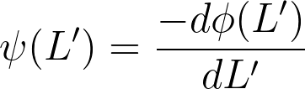
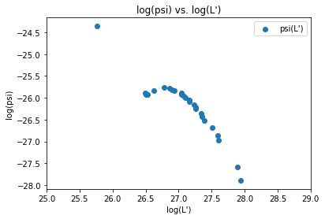
\Psi(L’)
Using the fitted polynomial as well as the formula on the right, I obtained the following graph:
I am not sure if the topmost point is a reliable point. Otherwise, there seems to be a peak between 26.5 and 27.

Slide 4
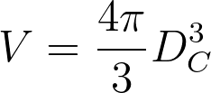
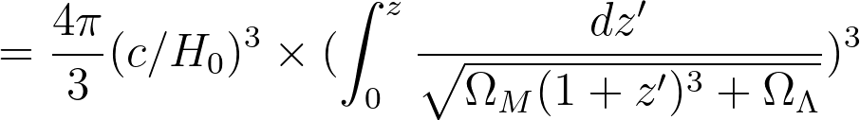
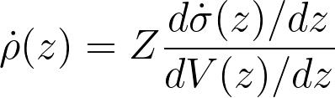
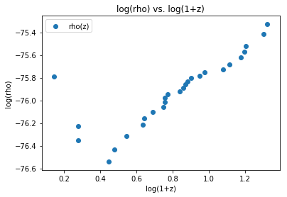
\rho(z)
Using the formulas for V and the data for sigma, I calculated rho(z). The values are extremely low, likely because these use units of m^-3 instead of Mpc^-3. There seems to be a dip in density, with the lowest near log(1+z) = 0.4

